Slide 1
Collaborative Solar Image Annotation
Professor Marios S. Pattichis
pattichis@gmail.com
Director, image and video Processing and Communications Lab
Chair, Computer Engineering Program
Dept of ECE, UNM
ivpcl.org

Slide 2
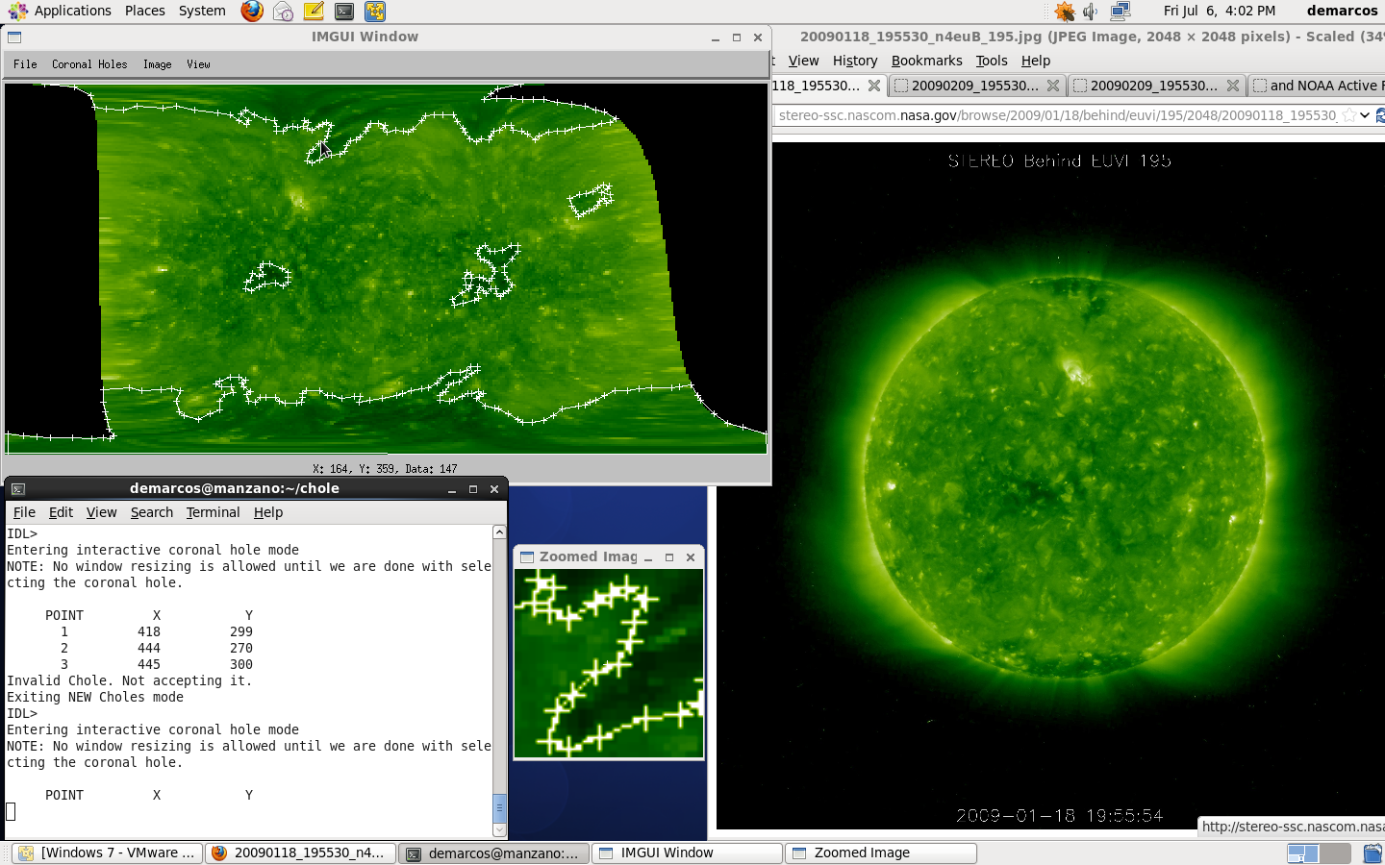
Motivation: Analyze Solar Images

Slide 3
General Project Requirments
Web App: it should run on a web server
Should retrieve solar images from the internet
Users should be allowed to annotate coronal holes on images
Support multiple users
Allow collaboration among users
Deliver the Web App code as open-source for further research

Slide 4
Software Outline
Work with free and open-source software that runs on standard browsers
Web App will use MySQL databases to store mouse clicks (points)
Users will also be stored in MySQL databases
Collaboration will need to implement MySQL database access protocols
NEW: Web App will need to use Canvas to plot images
I recommend that you follow the most popular textbook on how to do this:
Robin Nixon, “Learning PHP, MySQL, JavaScript, CSS & HTML5: A Step-by-Step Guide to Creating Dynamic Websites,” June 2014.

Slide 5
Sponsoring Entity
UNM ECE Professor Marios S. Pattichis
Director of image and video Processing and Communications Lab (www.ivpcl.org)
AFRL Space Weather Center of Excellence
Dr. Nick Arge
Dr. Carl Henney
Dr. Rachel Hock

Slide 6
Why sponsor is interested
Space weather can cause significant damage to spacecraft operations (e.g., GPS), astronauts, radio communications, and the power grid
Solar image analysis is required for space weather prediction
Web App technology will replace IDL interface and provide fast response to events
Nice teaching tool for Computer Engineering students who want to learn how to do Web Apps

Slide 7
Deliverables as requested by sponsor
Running Web App
Web App source files and data
PHP, MySQL, Javascript, HTML, and CSS only

Slide 8
Resources to be provided by sponsor
Face to face tutorials on the basic Web App development
Face to face meetings in ECE lobby

Slide 9
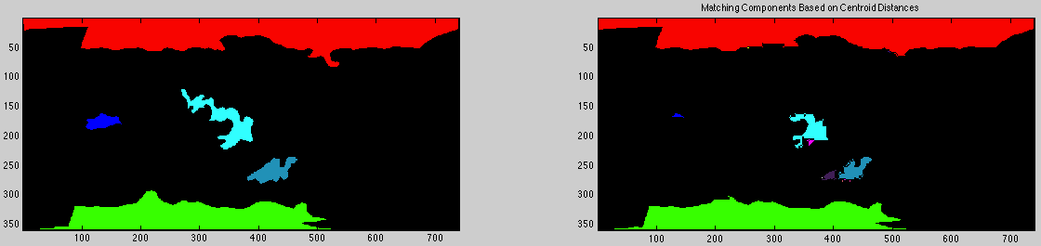
Automatic Coronal Hole Matching SW This is provided to you!
Developed in Matlab and ported to OpenCV to allow you to visualize how good is an image analysis method for detecting coronal holes.

Slide 10
Points of contact
Primary UNM Sponsor:
Prof. Marios S. Pattichis
Email: pattichis@gmail.com
Phone: 277-0486
AFRL Sponsor:
Dr. Nick Arge
Email: nick.arge@kirtland.af.mil

Slide 11
Top Ten Reasons to Pick This Project
You want to save the world from a Solar attack.
You might get a summer job as an AFRL scholar.
You want to know how to pull data from the WEB.
Dr. Pattichis is a cool Professor.
Learn more about collaborative Web APPs.
Learn more about HTML and CSS.
Learn more about PHP.
3. Learn more about Javascript and Canvas.
You want a nice research project that will get you in a good graduate program (including UNM).
1. You might get a real job related to your project.

Slide 12
Any Questions?

